Slide 1
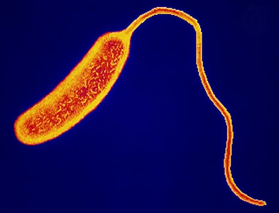
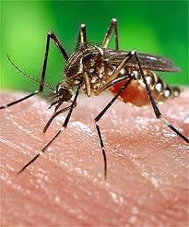
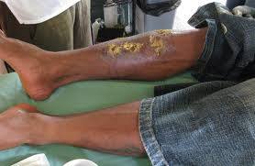
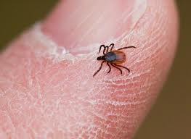
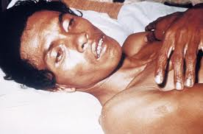
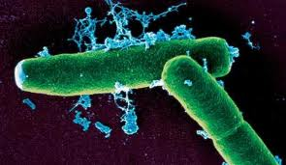
Infectious Diseases
Lesson 1.2

Slide 2
Lesson Objectives:
After finishing today’s lesson, you will be able to:
list a number of globally significant infectious diseases and be able to explain how they impact mortality.
explain the societal effects of infectious diseases.
apply what you have learned today to explain the consequences of the HIV epidemic in Africa.

Slide 3
Do Now
Use your homework to discuss the following with a partner:
What diseases did you choose? Are they caused by a virus, a bacteria or a parasite?
What source did you use to determine that they are globally significant?
Notes:
Ask the students: how they found the evidence that the disease is globally significant.
Reputable sources include:
The World Health Organization
The Centers for Disease Control
The National Institutes of Health
The Wellcome Foundation

Slide 4
Activity
The world population is approximately 7 billion people.
How many individuals do you think died since January this year from:
How many people do you think are infected with:
Tuberculosis (TB)
HIV / AIDS
Malaria
Diarrheal Diseases
HIV
Malaria
Notes:
Teacher should briefly explain the diseases.
Malaria – a parasitic disease caused by plasmodium which are carried by mosquitoes. The parasite infects Red Blood Cells (RBC) causing fever, shivering, joint pain, vomiting, and anemia (as a result of RBC damage).
TB – a bacterial disease caused by Mycobacterium tuberculosis. The bacteria are transmitted via coughing and inhaling of micro droplets. This leads to shortness of breath, coughing, fever sweats etc…this can usually be cured with antibiotics
AIDS – a viral disease caused by a virus (HIV) which attacks T cells. The infected T cells are then damaged leading to impaired immunity.

Slide 5
Use the Poodwaddle Clock to find the real-time numbers
http://www.poodwaddle.com/worldclock.swf
Notes:
Ask the students: to write down three reasons they may have underestimated the prevalence of disease.

Slide 6
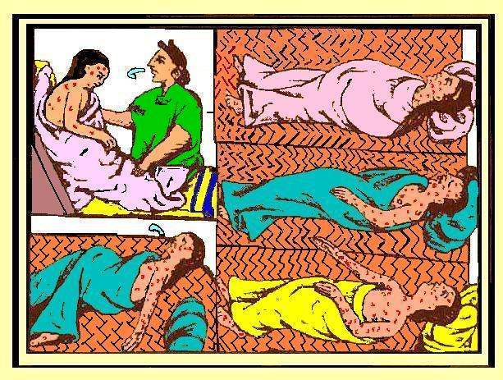
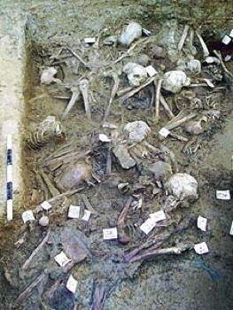
One of the first recorded plagues
The Antonine plague 165 AD

Slide 7
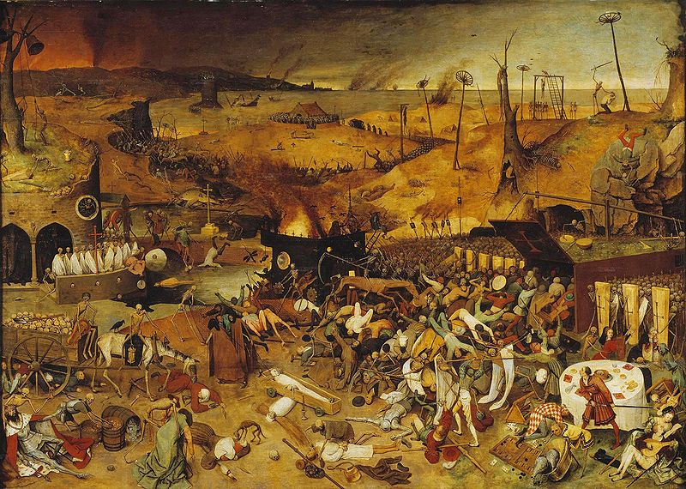
One of the worst plagues
Bubonic plague – the Black Death
Notes:
Ask the students: whether the world population is increasing. They should say yes.
Ask the students: to imagine some effects that reducing the population by half may have had on society.
Ask the students: to imagine the population shrinking by 30-60%. You can illustrate this in the classroom by dividing the class into half. Half the population died when the black plague ravaged Europe in the 1300s.

Slide 8
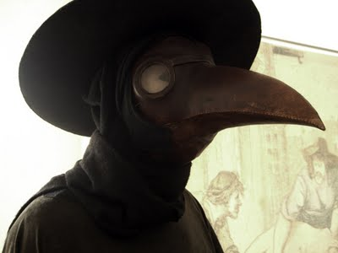
Dealing with the Black Death
Plague mask
Notes:
Have the students guess what this outfit is for. They may think it looks like a costume for a cult or Halloween.

Slide 9
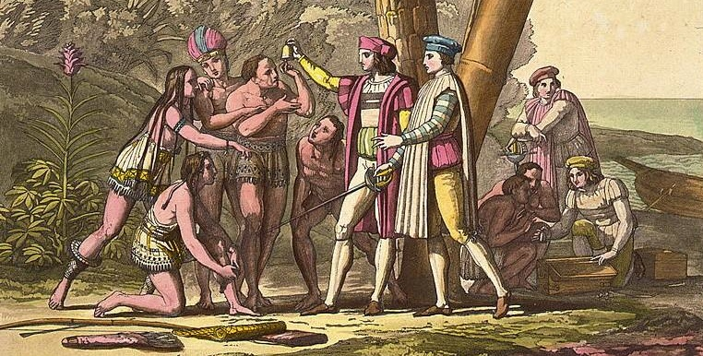
Columbus and his plagues:
both sides at risk
Smallpox and measles carried to North America by Spanish explorers killed millions but the trip cut both ways: Christopher Columbus took syphilis back to Europe.

Slide 10
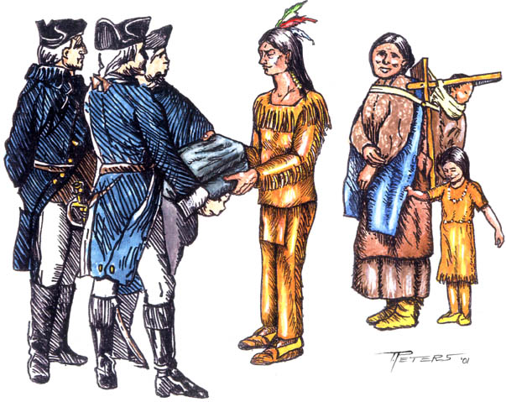
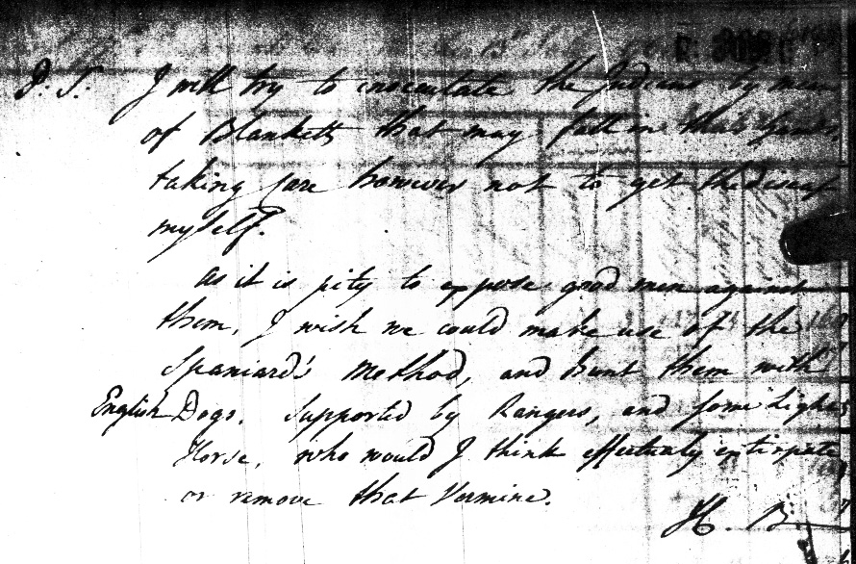
Plagues as bioterrorism
“P.S. I will try to inocculate the Indians by means of Blankets that may fall in their hands, taking care however not to get the disease myself. As it is pity to oppose good men against them, I wish we could make use of the Spaniard's Method, and hunt them with English Dogs. Supported by Rangers, and some Light Horse, who would I think effectively extirpate or remove that Vermine.”
(Colonel Henry Boquet, letter to Lord Jeffrey Amherst, Commander of British Forces July 13th 1763)

Slide 11
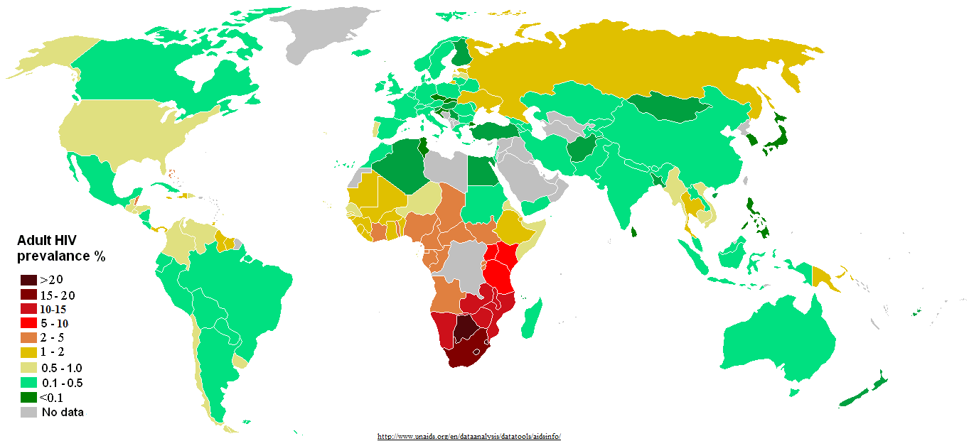
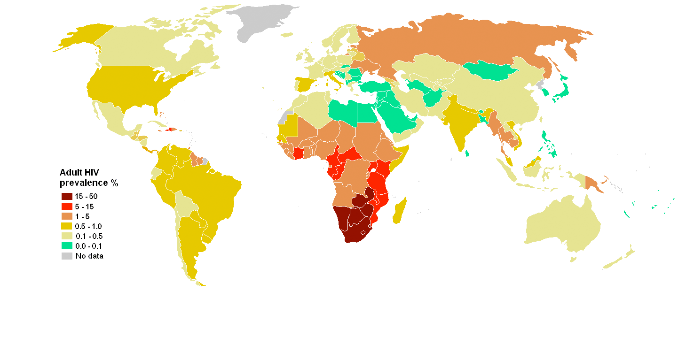
HIV in 2013 – What are the effects of this pandemic?
Notes:
Ask the students: how the HIV pandemic could change the course of African history - because sickness leads to less productivity, poverty and then a cycle that is difficult to break.

Slide 12
Homework
List 4-5 behaviors we use to avoid transmission of infectious diseases, and explain what they might prevent.

